Slide 1
Features of C
Presented By S.R.Zameer

Slide 2
Features of C
Simple
Portability
Powerful
Platform dependent
Structure oriented

Slide 3
Features of C
Case sensitive
Compiler based
Middle level language
Syntax based language
Use of Pointers

Slide 4
Simple
Every c program can be written in simple English language so that it is very easy to understand and developed by programmer.

Slide 5
Platform dependent
A language is said to be platform dependent whenever the program is execute in the same operating system where that was developed and compiled but not run and execute on other operating system. C is platform dependent programming language.

Slide 6
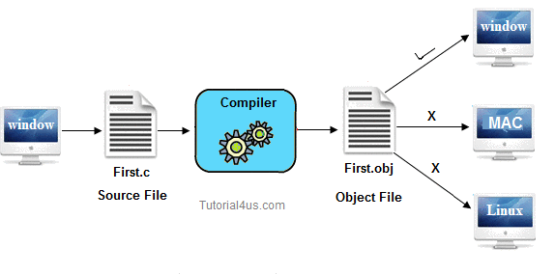

Slide 7
Portability
It is the concept of carrying the instruction from one system to another system. In C Language .C file contain source code, we can edit also this code. .exe file contain application, only we can execute this file. When we write and compile any C program on window operating system that program easily run on other window based system.

Slide 8
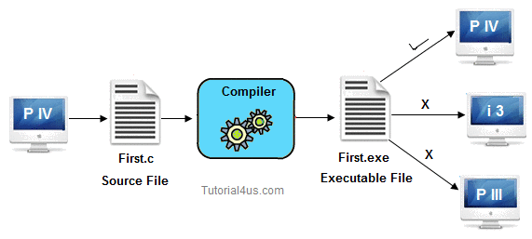

Slide 9
Powerful
C is a very powerful programming language, it have a wide verity of data types, functions, control statements, decision making statements, etc.

Slide 10
Structure oriented
C is a Structure oriented programming language. Structure oriented programming language aimed on clarity of program, reduce the complexity of code, using this approach code is divided into sub-program/subroutines. These programming have rich control structure.

Slide 11
Case sensitive
It is a case sensitive programming language. In C programming 'break and BREAK' both are different.
If any language treats lower case latter separately and upper case latter separately than they can be called as case sensitive programming language [Example c, c++, java, .net are sensitive programming languages.] other wise it is called as case insensitive programming language [Example HTML, SQL is case insensitive programming languages].

Slide 12
Middle level language
C programming language can supports two level programming instructions with the combination of low level and high level language that's why it is called middle level programming language.

Slide 13
Compiler based
C is a compiler based programming language that means without compilation no C program can be executed. First we need compiler to compile our program and then execute.

Slide 14
Syntax based language
C is a strongly tight syntax based programming language. If any language follow rules and regulation very strictly known as strongly tight syntax based language. Example C, C++, Java, .net etc. If any language not follow rules and regulation very strictly known as loosely tight syntax based language. Example HTML.

Slide 15
Efficient use of pointers
Pointers is a variable which hold the address of another variable, pointer directly direct access to memory address of any variable due to this performance of application is improve. In C language also concept of pointer are available.

